Slide 1

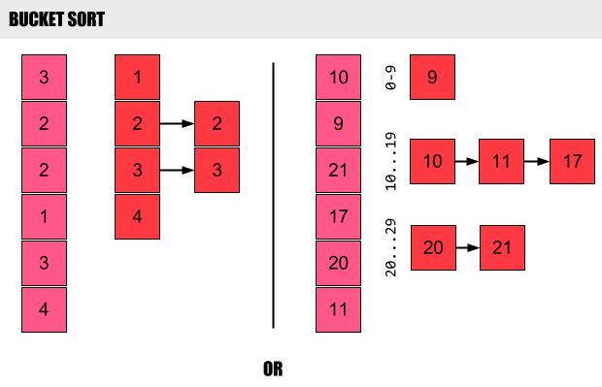

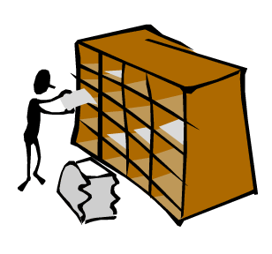
Sorting and Searching Algorithms
Nikolay Kostov
Senior Software Developer and Technical Trainer
http://Nikolay.IT
Telerik Software Academy
academy.telerik.com

Slide 2


Table of Contents
Sorting
Sorting and classification
Review of the most popular sorting algorithms
Searching
Linear search
Binary search
Interpolation search
Shuffling

Slide 3

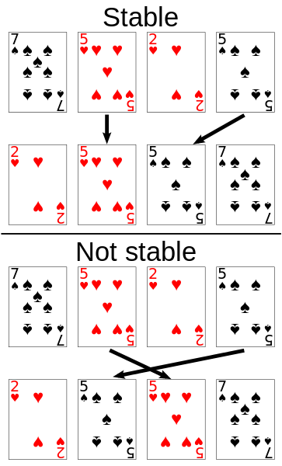
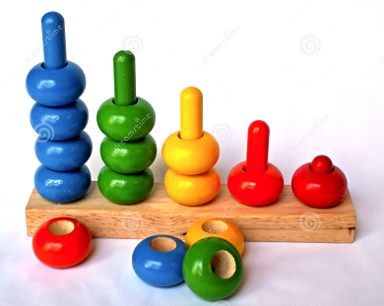
Sorting

Slide 4
What is a Sorting Algorithm?
Sorting algorithm
An algorithm that puts elements of a list in a certain order (most common lexicographically)
More formally:
The output is in some (non-decreasing) order
The output is a permutation of the input
Efficient sorting is important for
producing human-readable output
canonicalizing data
optimizing the use of other algorithms
Sorting presents many important techniques

Slide 5
Classification
Sorting algorithms are often classified by
Computational complexity
worst, average and best behavior
Memory usage
Recursive or non-recursive
Stability
Whether or not they are a comparison sort
General method
insertion, exchange (bubble sort and quicksort), selection (heapsort), merging, serial or parallel…

Slide 6
Stability of Sorting
Stable sorting algorithms
Maintain the relative order of records with equal values
If two items compare as equal, then their relative order will be preserved
When sorting only part of the data is examined when determining the sort order

Slide 7
Selection sort
Very simple and very inefficient algorithm
Best, worst and average case: n²
Memory: 1 (constant, only for the min element)
Stable: No
Method: Selection
http://en.wikipedia.org/wiki/Selection_sort
for (j = 0; j < n-1; j++) {
/* find the min element in the unsorted a[j .. n-1] */
iMin = j;
for ( i = j+1; i < n; i++) {
if (a[i] < a[iMin]) iMin = i;
}
if (iMin != j) swap(a[j], a[iMin]);
}

Slide 8
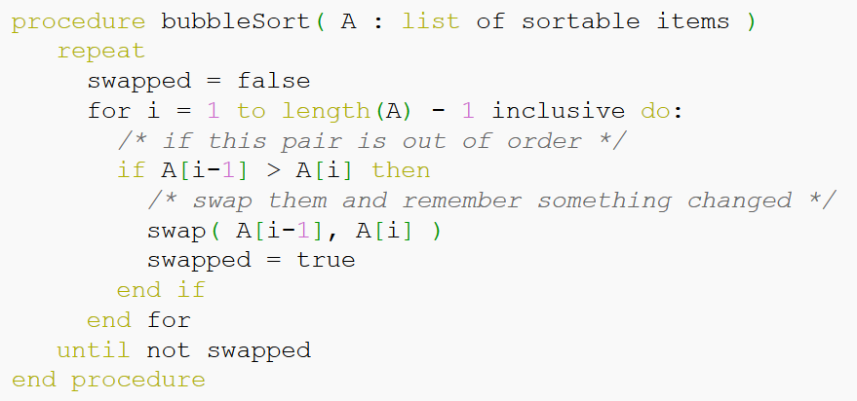
Bubble sort
Repeatedly stepping through the list, comparing each pair of adjacent items and swap them if they are in the wrong order
Best case: n, worst and average case: n²
Memory: 1, Stable: Yes, Method: Exchanging
http://en.wikipedia.org/wiki/Bubble_sort

Slide 9
Insertion sort
Builds the final sorted array one item at a time
Best case: n, worst and average case: n²
Memory: 1, Stable: Yes, Method: Insertion
http://en.wikipedia.org/wiki/Insertion_sort
for i ← 1 to i ← length(A)-1
{
valueToInsert ← A[i]
holePos ← i
while holePos > 0 and valueToInsert < A[holePos - 1]
{
A[holePos] ← A[holePos - 1] // shift the larger value up
holePos ← holePos - 1 // move the hole position down
}
A[holePos] ← valueToInsert
}

Slide 10
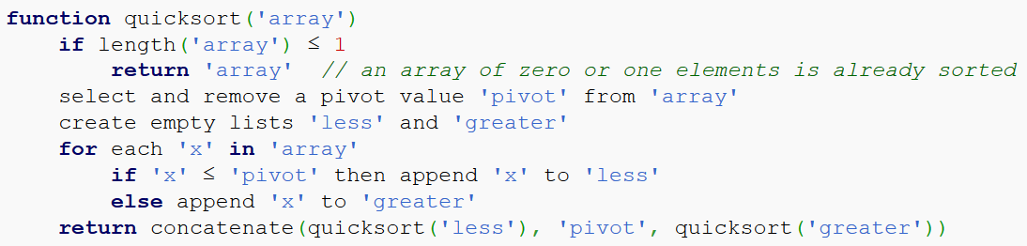
Quicksort
First divides a large list into two smaller sub-lists then recursively sort the sub-lists
Best and average case: n*log(n), worst: n²
Memory: log(n) stack space
Stable: Depends
Method: Partitioning
http://en.wikipedia.org/wiki/Quicksort
Stable implementation

Slide 11
Merge Sort
Conceptually, a merge sort works as follows
Divide the unsorted list into n sublists, each containing 1 element (list of 1 element is sorted)
Repeatedly merge sublists to produce new sublists until there is only 1 sublist remaining
Best, average and worst case: n*log(n)
Memory: Depends; worst case is n
Stable: Yes; Method: Merging
Highly parallelizable (up to O(log(n)) using the Three Hungarian's Algorithm
http://en.wikipedia.org/wiki/Merge_sort

Slide 12
Merge Sort Pseudocode
function merge_sort(list m)
// if list size is 0 (empty) or 1, consider it sorted
// (using less than or equal prevents infinite recursion for a zero length m)
if length(m) <= 1
return m
// else list size is > 1, so split the list into two sublists
var list left, right
var integer middle = length(m) / 2
for each x in m before middle
add x to left
for each x in m after or equal middle
add x to right
// recursively call merge_sort() to further split each sublist
// until sublist size is 1
left = merge_sort(left)
right = merge_sort(right)
// merge the sublists returned from prior calls to merge_sort()
// and return the resulting merged sublist
return merge(left, right)

Slide 13
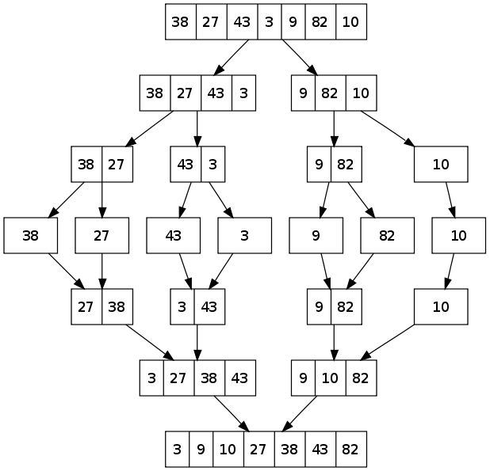
Merge Sort Pseudocode (2)
function merge(left, right)
var list result
while length(left) > 0 or length(right) > 0
if length(left) > 0 and length(right) > 0
if first(left) <= first(right)
append first(left) to result
left = rest(left)
else
append first(right) to result
right = rest(right)
else if length(left) > 0
append first(left) to result
left = rest(left)
else if length(right) > 0
append first(right) to result
right = rest(right)
end while
return result

Slide 14
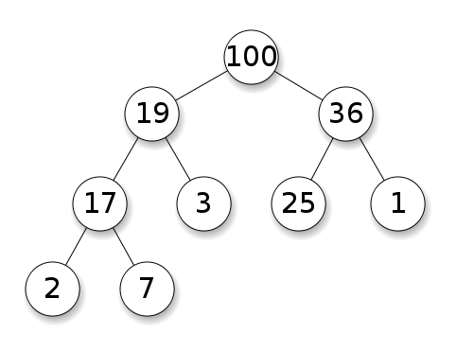
Heap
Specialized tree-based data structure that satisfies the heap property:
Parent nodes are always greater (less) than or equal to the children
No implied ordering between siblings or cousins
en.wikipedia.org/wiki/Heap_(data_structure)
find-min | Θ(1)
delete-min | Θ(log n)
insert | Θ(log n)
decrease-key | Θ(log n)
merge | Θ(n)

Slide 15
Heapsort
Can be divided into two parts
In the first step, a heap is built out of the data
A sorted array is created by repeatedly removing the largest element from the heap
Best, average and worst case: n*log(n)
Memory: Constant - O(1)
Stable: No
Method: Selection
http://en.wikipedia.org/wiki/Heapsort

Slide 16
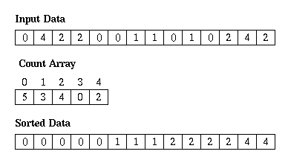
Counting sort
Algorithm for sorting a collection of objects according to keys that are small integers
Not a comparison sort
Average case: n + r
Worst case: n + r
r is the range of numbers to be sorted
Stable: Yes
Memory: n + r
http://en.wikipedia.org/wiki/Counting_sort

Slide 17
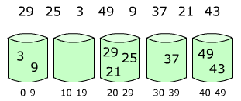
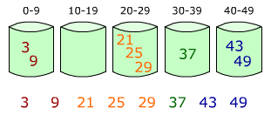
Bucket sort
Partitioning an array into a number of buckets
Each bucket is then sorted individually
Not a comparison sort
Average case: n + k
k = the number of buckets
Worst case: n² * k
Stable: Yes
Memory: n * k
http://en.wikipedia.org/wiki/Bucket_sort

Slide 18
Comparison of Sorting Algorithms
There are hundreds of sorting algorithms
Name | Best | Average | Worst | Memory | Stable | Method
Selection sort | n² | n² | n² | 1 | No | Selection
Bubble sort | n | n² | n² | 1 | Yes | Exchanging
Insertion sort | n | n² | n² | 1 | Yes | Insertion
Quicksort | n*log(n) | n*log(n) | n² | log(n) | Depends | Partitioning
Merge sort | n*log(n) | n*log(n) | n*log(n) | Depends worst case is n | Yes | Merging
Heapsort | n*log(n) | n*log(n) | n*log(n) | 1 | No | Selection
Bogosort | n | n*n! | n*n! | 1 | No | Luck
… | … | … | … | … | … | …

Slide 19

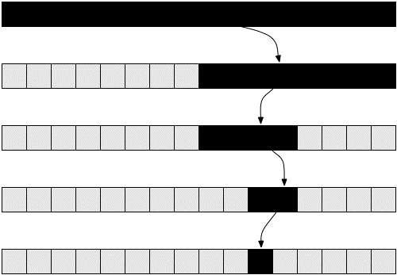
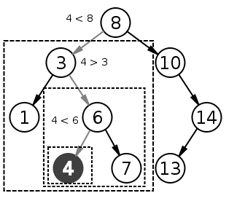
Searching

Slide 20

Search Algorithm
An algorithm for finding an item with specified properties among a collection of items
Different types of searching algorithms
For virtual search spaces
satisfy specific mathematical equations
try to exploit partial knowledge about structure
For sub-structures of a given structure
graph, a string, a finite group
Search for the max (min) of a function
etc.

Slide 21
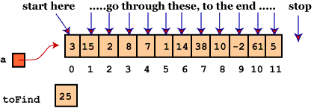
Linear Search
Method for finding a particular value in a list
Checking every one of the elements
One at a time in sequence
Until the desired one is found
Worst and average performance: O(n)
for each item in the list:
if that item has the desired value,
stop the search and return the item's location.
return nothing.

Slide 22

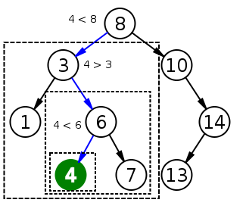
Binary Search
Finds the position of a specified value within a sorted data structure
In each step, compare the input with the middle
The algorithm repeats its action to the left or right sub-structure
Average performance: O(log(n))

Slide 23
Recursive Binary Search
int binary_search(int A[], int key, int imin, int imax)
{
if (imax < imin)
// set is empty, so return value showing not found
return KEY_NOT_FOUND;
else
{
// calculate midpoint to cut set in half
int imid = midpoint(imin, imax);
if (A[imid] > key)
// key is in lower subset
return binary_search(A, key, imin, imid-1);
else if (A[imid] < key)
// key is in upper subset
return binary_search(A, key, imid+1, imax);
else
// key has been found
return imid;
}
}

Slide 24
Iterative Binary Search
int binary_search(int A[], int key, int imin, int imax)
{
// continue searching while [imin,imax] is not empty
while (imax >= imin)
{
/* calculate the midpoint for roughly equal partition */
int imid = midpoint(imin, imax);
// determine which subarray to search
if (A[imid] < key)
// change min index to search upper subarray
imin = imid + 1;
else if (A[imid] > key)
// change max index to search lower subarray
imax = imid - 1;
else
// key found at index imid
return imid;
}
return KEY_NOT_FOUND;
}

Slide 25
Interpolation Search
An algorithm for searching for a given key value in an indexed array that has been ordered by the values of the key
Parallels how humans search through a telephone book
Calculates where in the remaining search space the sought item might be
Binary search always chooses the middle element
Average case: log(log(n)), Worst case: O(n)
http://youtube.com/watch?v=l1ed_bTv7Hw

Slide 26
Interpolation Search Sample Implementation
public int interpolationSearch(int[] sortedArray, int toFind){
// Returns index of toFind in sortedArray, or -1 if not found
int low = 0;
int high = sortedArray.length - 1;
int mid;
while(sortedArray[low] <= toFind && sortedArray[high] >= toFind) {
mid = low + ((toFind - sortedArray[low]) * (high - low)) /
(sortedArray[high] - sortedArray[low]);
// out of range is possible here
if (sortedArray[mid] < toFind)
low = mid + 1;
else if (sortedArray[mid] > toFind)
high = mid - 1;
else
return mid;
}
if (sortedArray[low] == toFind) return low;
else return -1; // Not found
}

Slide 27

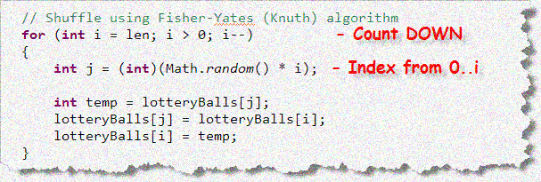
Shuffling

Slide 28

Shuffling
A procedure used to randomize the order of items in a collection
Generating random permutation
http://en.wikipedia.org/wiki/Shuffling

Slide 29
Fisher–Yates shuffle algorithm
public static IEnumerable<T> Shuffle<T>(this IEnumerable<T> source)
{
var array = source.ToArray();
var n = array.Length;
for (var i = 0; i < n; i++)
{
// Exchange a[i] with random element in a[i..n-1]
int r = i + RandomProvider.Instance.Next(0, n - i);
var temp = array[i];
array[i] = array[r];
array[r] = temp;
}
return array;
}
public static class RandomProvider
{
private static Random Instance = new Random();
}

Slide 30
Sorting and Searching Algorithms
http://academy.telerik.com

Slide 31
Homework
Open Sorting-and-Searching-Algorithms-Homework.zip and:
Implement SelectionSorter.Sort() method using selection sort algorithm
Implement Quicksorter.Sort() method using quicksort algorithm
Implement MergeSorter.Sort() method using merge sort algorithm
Implement SortableCollection.LinearSearch() method using linear search
Don’t use built-in search methods. Write your own.

Slide 32
Homework (2)
Implement SortableCollection.BinarySearch() method using binary search algorithm
Implement SortableCollection.Shuffle() method using shuffle algorithm of your choice
Document what is the complexity of the algorithm
* Unit test sorting algorithms
SelectionSorter.Sort()
Quicksorter.Sort()
MergeSorter.Sort()
* Unit test searching algorithms
SortableCollection.LinearSearch()
SortableCollection.BinarySearch()

Slide 33




Free Trainings @ Telerik Academy
C# Programming @ Telerik Academy
csharpfundamentals.telerik.com
Telerik Software Academy
academy.telerik.com
Telerik Academy @ Facebook
facebook.com/TelerikAcademy
Telerik Software Academy Forums
forums.academy.telerik.com

